Slide 1

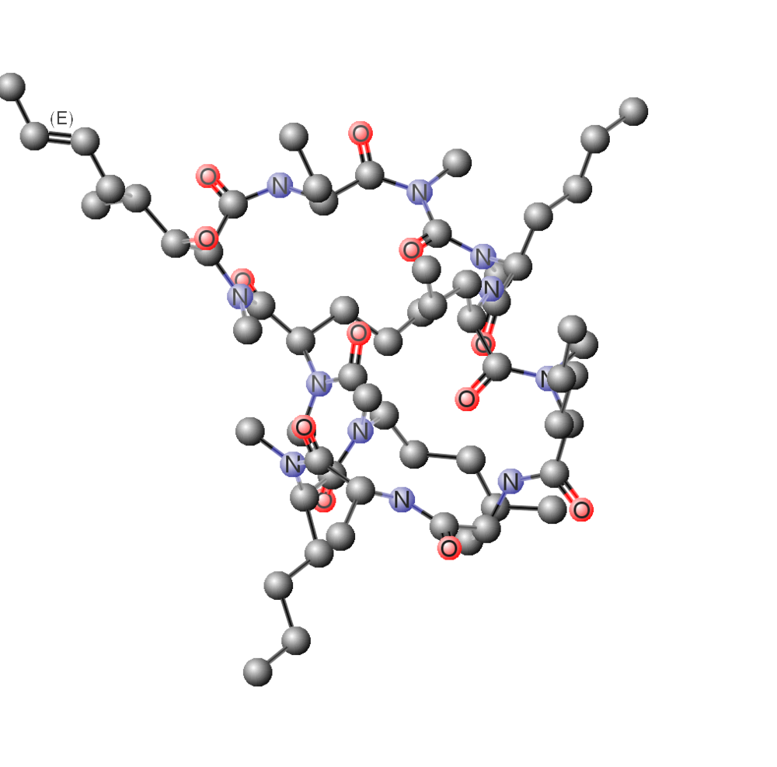
Dialysis pred
Machine learning for dialysis prediction in critical (ICU) patients

Slide 2


Acute Kidney Injury: How likely is that an AKI-ICU patient needs dialysis machines?
Akute Kideny Disease: Predicting the needs of dialysis machines within AKI-ICU patients
Notes:
Acute kidney injury (AKI) is a sudden episode of kidney failure or kidney damage that happens within a few hours or a few days. AKI causes a build-up of waste products in your blood and makes it hard for your kidneys to keep the right balance of fluid in your body. AKI can also affect other organs such as the brain, heart, and lungs. Acute kidney injury is common in patients who are in the hospital, in intensive care units, and especially in older adults.
https://www.ncbi.nlm.nih.gov/pubmed/28182800

Slide 3
The problem
Close to 50% of the expenditures are related to the provision of maintenance dialysis.
Current AKI - ICU therapies in the US:
Continuous Renal Replacement Therapy (CRRT) $37,780
Intermittent Renal Replacement Therapy (IRRT) $39,448
https://www.ncbi.nlm.nih.gov/pmc/articles/PMC5743773/
https://www.ncbi.nlm.nih.gov/pmc/articles/PMC5332811/
$ Days
AKI has emerged as a major public health concern with high human and financial costs, which were comparable to those for stroke, pancreatitis, and pneumonia
AKI NO DIALYSIS
AKI DIALYSIS
Notes:
Treatment for AKI usually requires you to stay in a hospital. Most people with acute kidney injury are already in the hospital for another reason. How long you will stay in the hospital depends on the cause of your AKI and how quickly your kidneys recover. In more serious cases, dialysis may be needed to help replace kidney function until your kidneys recover.
AKI was associated with an increase in hospitalization costs of $7933 (95% confidence interval [CI], $7608-$8258) and an increase in LOS of 3.2 (95% CI, 3.2-3.3) days compared to patients without AKI. When adjusted for patient and hospital characteristics, the associated increase in costs was $1795 (95% CI, $1692-$1899) and in LOS, it was 1.1 (95% CI, 1.1-1.1) days. Corresponding results among patients hospitalized with AKI requiring dialysis were $42,077 (95% CI, $39,820-$44,335) and 11.5 (95% CI, 11.2-11.8) days and $11,016 (95% CI, $10,468-$11,564) and 3.9 (95% CI, 3.8-4.1) days. AKI was associated with higher hospitalization costs than myocardial infarction and gastrointestinal bleeding, and costs were comparable to those for stroke, pancreatitis, and pneumonia..
Acute kidney injury (AKI) is an increasingly common condition associated with poor health outcomes. Combined with its rising incidence, AKI has emerged as a major public health concern with high human and financial costs. In England, the estimated inpatient costs related to AKI consume 1% of the National Health Service budget. In the United States, AKI is associated with an increase in hospitalization costs that range from $5.4 billion to $24.0 billion. The most expensive patients are those with AKI of sufficient severity to require dialysis, where cost increases relative to patients without AKI range from $11,016 to $42,077 per hospitalization.

Slide 4

The solution
Early diagnosis of dialysis needs
Cost reduction of AKI diagnosis and treatment
Cost reduction and improvement of hospital resources management
Dialysis pred
Forecasting dialysis needs among AKI critical patients

Slide 5




Data Workflow
From eICU MIT’s database to Dialysis Pred attributes: Data gathering, mining and exploration.
Look at the big picture -> Frame the problem -> Gain insights -> Prepare for ML Algorithms
MIT eICU
AKI critical patients
Dataset for ML
eICU derived (temp)
Dataset exploration
Google Cloud Engine VM
Google Cloud Storage
Big query
Github
Big query
Python: sklearn, np, pd, plt, stats
Data cleaning (NAs)
Feature scaling
Handling Text and Categorical Attributes
+30 GB
5.5 MB
Google Cloud Storage
Big query
Unbalanced data
Attributes combination
Correlations

Slide 6
Models
Binary classification problem in unbalanced dataset
Training models
Performance measures
Fine tuning parameters
https://www.ncbi.nlm.nih.gov/pmc/articles/PMC5743773/
https://www.ncbi.nlm.nih.gov/pmc/articles/PMC5332811/
Balancing set: oversampling? Undersampling?
Adding/removing variables?
Is accuracy reliable?
ROC curves
Alternative metrics
Refining model
KNN
Naive bayes
Logistic regression
Random forest
SVM
AUC
Kappa-factor
Accuracy
n, C, ...
Notes:
Treatment for AKI usually requires you to stay in a hospital. Most people with acute kidney injury are already in the hospital for another reason. How long you will stay in the hospital depends on the cause of your AKI and how quickly your kidneys recover. In more serious cases, dialysis may be needed to help replace kidney function until your kidneys recover.
AKI was associated with an increase in hospitalization costs of $7933 (95% confidence interval [CI], $7608-$8258) and an increase in LOS of 3.2 (95% CI, 3.2-3.3) days compared to patients without AKI. When adjusted for patient and hospital characteristics, the associated increase in costs was $1795 (95% CI, $1692-$1899) and in LOS, it was 1.1 (95% CI, 1.1-1.1) days. Corresponding results among patients hospitalized with AKI requiring dialysis were $42,077 (95% CI, $39,820-$44,335) and 11.5 (95% CI, 11.2-11.8) days and $11,016 (95% CI, $10,468-$11,564) and 3.9 (95% CI, 3.8-4.1) days. AKI was associated with higher hospitalization costs than myocardial infarction and gastrointestinal bleeding, and costs were comparable to those for stroke, pancreatitis, and pneumonia..
Acute kidney injury (AKI) is an increasingly common condition associated with poor health outcomes. Combined with its rising incidence, AKI has emerged as a major public health concern with high human and financial costs. In England, the estimated inpatient costs related to AKI consume 1% of the National Health Service budget. In the United States, AKI is associated with an increase in hospitalization costs that range from $5.4 billion to $24.0 billion. The most expensive patients are those with AKI of sufficient severity to require dialysis, where cost increases relative to patients without AKI range from $11,016 to $42,077 per hospitalization.

Slide 7
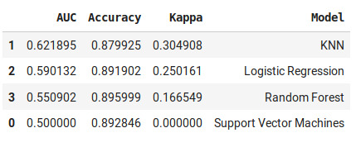
Results
Binary classification problem in unbalanced dataset
And the winner model is...
HEMATOCRIT
URINE OUTPUT
TOTAL OUTPUT
HEMOGLOBIN
CREATININE
AGE
APACHE IV
BLOOD UREA NITROGEN (BUN)
 | importance
ICU hours | 0,09338
Urine output | 0,069668
Creatinine Max | 0,048844
Total output | 0,043539
Creatinine Min | 0,035437
Hemoglobin Min | 0,029387
Age | 0,028676
Hematocrite Min | 0,028157
BUN Max | 0,026927
Apache IV | 0,026813
And the most determinant variables are...
Notes:
Treatment for AKI usually requires you to stay in a hospital. Most people with acute kidney injury are already in the hospital for another reason. How long you will stay in the hospital depends on the cause of your AKI and how quickly your kidneys recover. In more serious cases, dialysis may be needed to help replace kidney function until your kidneys recover.
AKI was associated with an increase in hospitalization costs of $7933 (95% confidence interval [CI], $7608-$8258) and an increase in LOS of 3.2 (95% CI, 3.2-3.3) days compared to patients without AKI. When adjusted for patient and hospital characteristics, the associated increase in costs was $1795 (95% CI, $1692-$1899) and in LOS, it was 1.1 (95% CI, 1.1-1.1) days. Corresponding results among patients hospitalized with AKI requiring dialysis were $42,077 (95% CI, $39,820-$44,335) and 11.5 (95% CI, 11.2-11.8) days and $11,016 (95% CI, $10,468-$11,564) and 3.9 (95% CI, 3.8-4.1) days. AKI was associated with higher hospitalization costs than myocardial infarction and gastrointestinal bleeding, and costs were comparable to those for stroke, pancreatitis, and pneumonia..
Acute kidney injury (AKI) is an increasingly common condition associated with poor health outcomes. Combined with its rising incidence, AKI has emerged as a major public health concern with high human and financial costs. In England, the estimated inpatient costs related to AKI consume 1% of the National Health Service budget. In the United States, AKI is associated with an increase in hospitalization costs that range from $5.4 billion to $24.0 billion. The most expensive patients are those with AKI of sufficient severity to require dialysis, where cost increases relative to patients without AKI range from $11,016 to $42,077 per hospitalization.

Slide 8

The technology:
WebApp for doctors

Slide 9
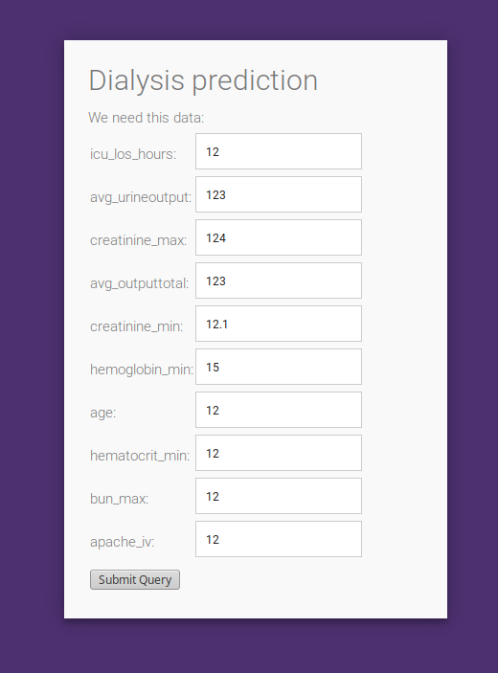

Web app
GUI for doctors and non-coders
http://albertsl.pythonanywhere.com/
Feel free to try our tool!
Notes:
Treatment for AKI usually requires you to stay in a hospital. Most people with acute kidney injury are already in the hospital for another reason. How long you will stay in the hospital depends on the cause of your AKI and how quickly your kidneys recover. In more serious cases, dialysis may be needed to help replace kidney function until your kidneys recover.
AKI was associated with an increase in hospitalization costs of $7933 (95% confidence interval [CI], $7608-$8258) and an increase in LOS of 3.2 (95% CI, 3.2-3.3) days compared to patients without AKI. When adjusted for patient and hospital characteristics, the associated increase in costs was $1795 (95% CI, $1692-$1899) and in LOS, it was 1.1 (95% CI, 1.1-1.1) days. Corresponding results among patients hospitalized with AKI requiring dialysis were $42,077 (95% CI, $39,820-$44,335) and 11.5 (95% CI, 11.2-11.8) days and $11,016 (95% CI, $10,468-$11,564) and 3.9 (95% CI, 3.8-4.1) days. AKI was associated with higher hospitalization costs than myocardial infarction and gastrointestinal bleeding, and costs were comparable to those for stroke, pancreatitis, and pneumonia..
Acute kidney injury (AKI) is an increasingly common condition associated with poor health outcomes. Combined with its rising incidence, AKI has emerged as a major public health concern with high human and financial costs. In England, the estimated inpatient costs related to AKI consume 1% of the National Health Service budget. In the United States, AKI is associated with an increase in hospitalization costs that range from $5.4 billion to $24.0 billion. The most expensive patients are those with AKI of sufficient severity to require dialysis, where cost increases relative to patients without AKI range from $11,016 to $42,077 per hospitalization.

Slide 10
Limitations
Handle such vast amount of data
Unbalanced dataset
Medical knowledge
Challenges we are still working on...

Slide 11



Future perspectives
Publish a paper
Apply to Google’s AI for social good impact grant
Give access to the tool for doctors around the world
Notes:
Treatment for AKI usually requires you to stay in a hospital. Most people with acute kidney injury are already in the hospital for another reason. How long you will stay in the hospital depends on the cause of your AKI and how quickly your kidneys recover. In more serious cases, dialysis may be needed to help replace kidney function until your kidneys recover.
AKI was associated with an increase in hospitalization costs of $7933 (95% confidence interval [CI], $7608-$8258) and an increase in LOS of 3.2 (95% CI, 3.2-3.3) days compared to patients without AKI. When adjusted for patient and hospital characteristics, the associated increase in costs was $1795 (95% CI, $1692-$1899) and in LOS, it was 1.1 (95% CI, 1.1-1.1) days. Corresponding results among patients hospitalized with AKI requiring dialysis were $42,077 (95% CI, $39,820-$44,335) and 11.5 (95% CI, 11.2-11.8) days and $11,016 (95% CI, $10,468-$11,564) and 3.9 (95% CI, 3.8-4.1) days. AKI was associated with higher hospitalization costs than myocardial infarction and gastrointestinal bleeding, and costs were comparable to those for stroke, pancreatitis, and pneumonia..
Acute kidney injury (AKI) is an increasingly common condition associated with poor health outcomes. Combined with its rising incidence, AKI has emerged as a major public health concern with high human and financial costs. In England, the estimated inpatient costs related to AKI consume 1% of the National Health Service budget. In the United States, AKI is associated with an increase in hospitalization costs that range from $5.4 billion to $24.0 billion. The most expensive patients are those with AKI of sufficient severity to require dialysis, where cost increases relative to patients without AKI range from $11,016 to $42,077 per hospitalization.

Slide 12
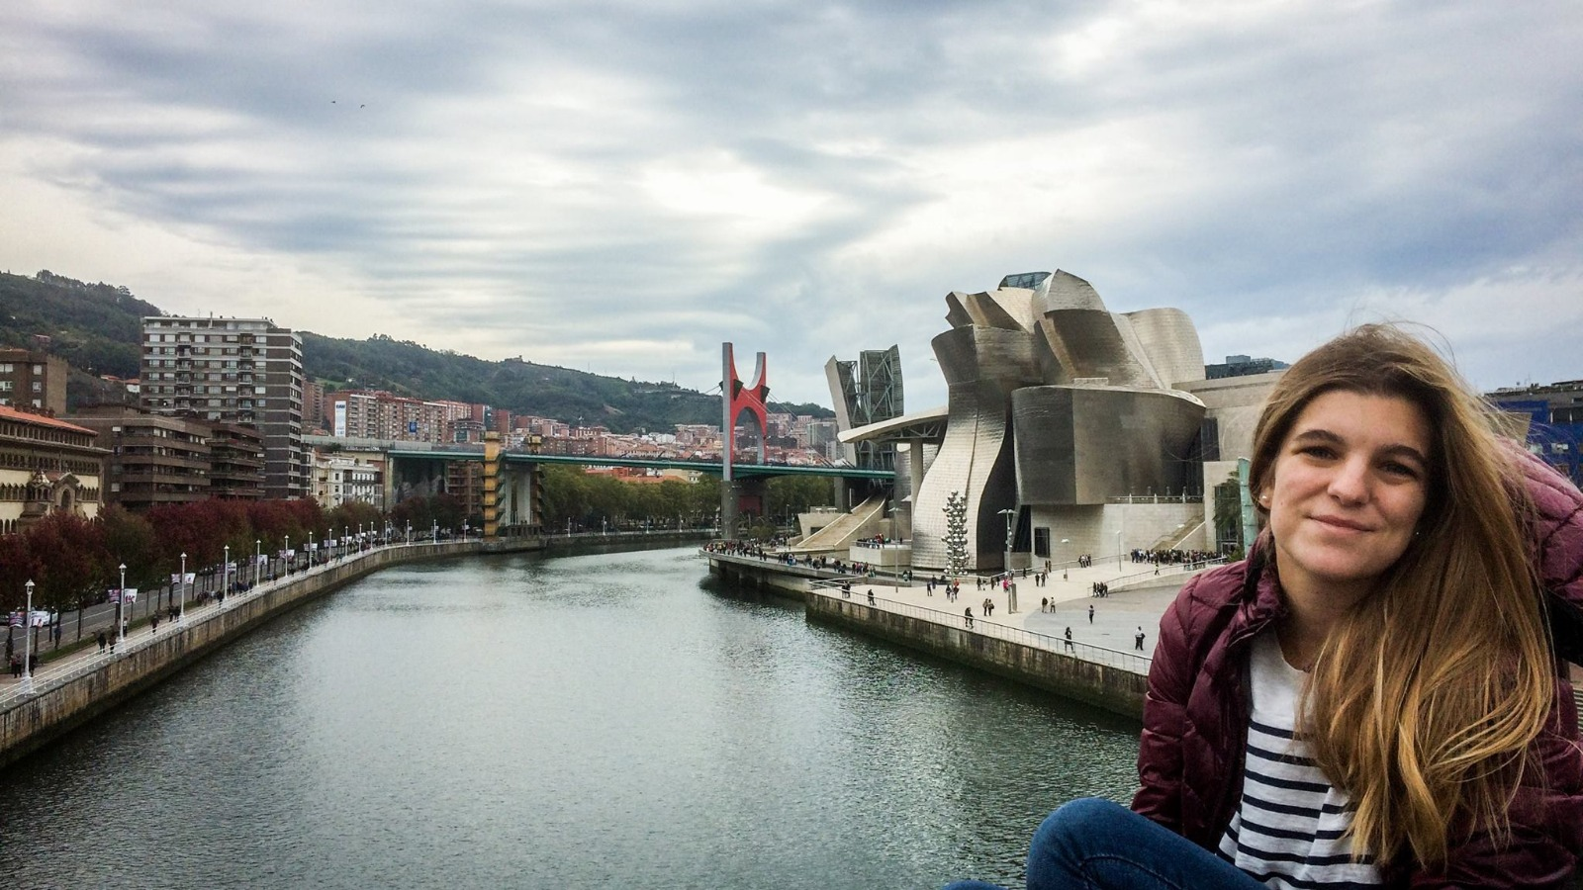



The team
We are machine learning enthusiasts, curious and fascinated by the potential of AI to transform the world we live in
Uxue Lazkano
Elisa G. de Lope
Albert Sanchez
Biochemist, Bioinformatician and Data Scientist at the Neurology department of Hospital del Mar
Data scientist
Biotech & Bioinformatics
Data analyst at Capgemini
Data scientist
Industrial Engineer
Fibre optic cable product engineer at OPTRAL
uxue-lazcano-dobao
elisagdelope
albertsl

